Slide 1
Swift Closures

Slide 2
Closures
Closures are anonymous functions (often referred to as lambdas or blocks in other languages). They are blocks of code that you can pass as arguments to functions where the receiving function expects a function type.
In Swift, closures are a special type of functions that can be defined without the use of the func keyword and a function name.
Just like functions, the closures can accept parameters and return values.
A closure also has a set of statements that will be executed once the closure is called.
Just like functions, a closure can be assigned to a variable or a constant.

Slide 3
Introduction
Closures Declaration
In Swift, a closure is a special type of function without the function name. For example
{
print("Hello World")
}
Swift Closure Declaration:
We don't use the func keyword to create closure
{ (parameters) -> returnType in
// statements
}

Slide 4
Introduction
Closures Declaration
Swift Closure Declaration:
We don't use the func keyword to create closure
{ (parameters) -> returnType in
// statements
}
Here,
parameters - any value passed to closure
returnType - specifies the type of value returned by the closure
in (optional) - used to separate parameters/returnType from closure body

Slide 5
Example
var greet = {
print("Hello, World!")
}
Here, we have defined a closure and assigned it to the variable named greet. Statement enclosed inside the {} is the closure body.
To execute this closure, we need to call it. Here's how we can call the closure
// call the closure
greet()
//Output : Hello World

Slide 6
Example
let addTwoNumbers = { (a: Int, b: Int) -> Int in
return a + b
}
let sum = addTwoNumbers(3, 5)
print(sum)
// Output: 8

Slide 7
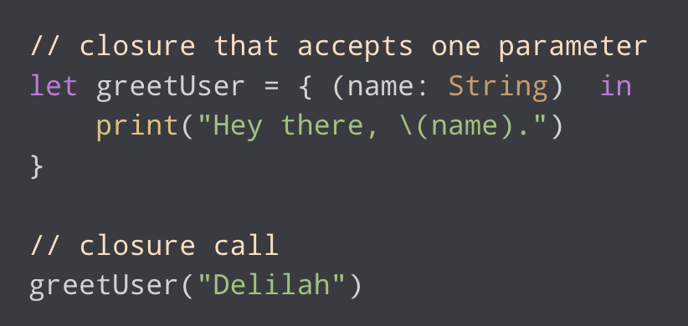
Closure Parameters
Similar to functions, a closure can also accept parameters. For example,
//Output: Hey there, Delilah
Notice that we have used in to separate closure parameter with body.
Call of Closure
greetUser("Delilah")

Slide 8
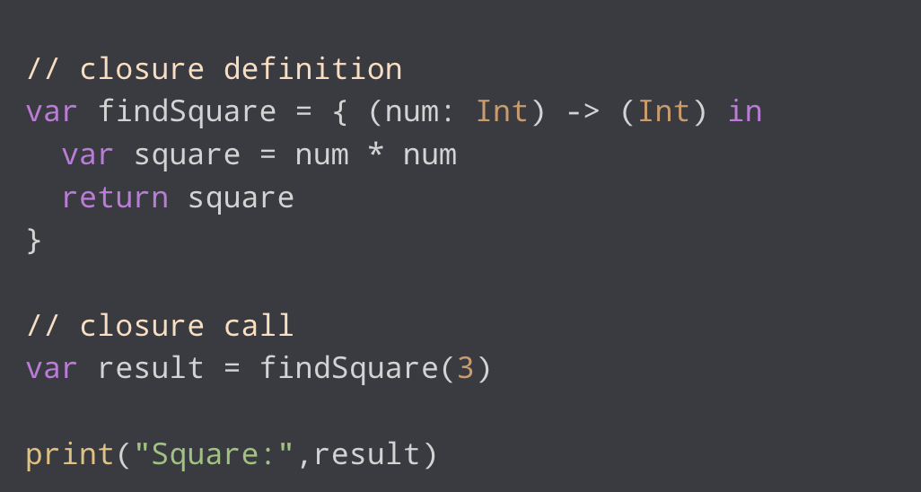
Closure That Returns Value
A Swift closure may or may not return a value.
If we want our closure to return some value, we need to mention it's return type and use the return statement.

Slide 9
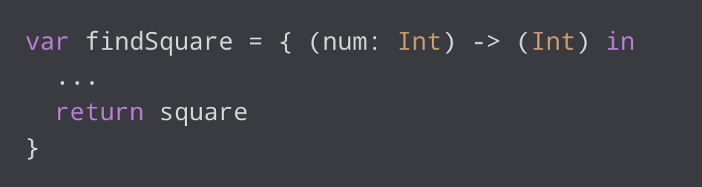
Closure That Returns Value
Notice the closure definition,
Here, (num: Int) -> (Int) indicates that the closure
(num: Int) - indicates the parameter of integer type
-> (Int) - represents the closure return value of Int type
return square - return statement inside the closure
The returned value is stored in the result variable.

Slide 10
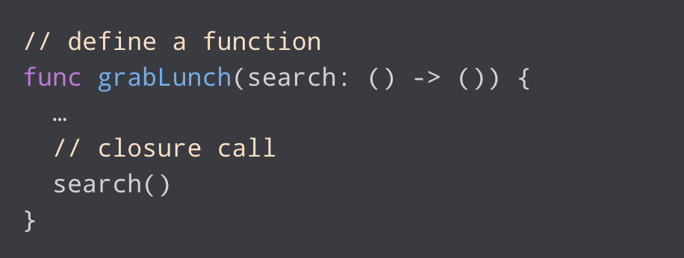
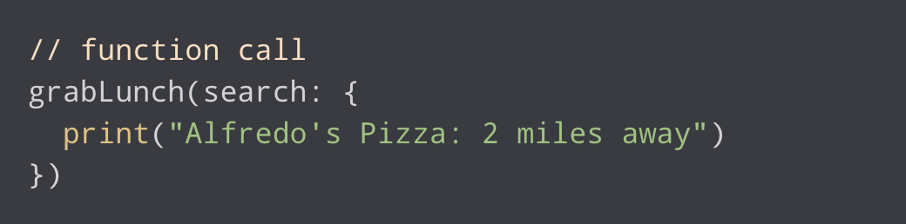
Closures as Function Parameter
In Swift, we can create a function that accepts closure as its parameter.
Here,
search - function parameter
() -> () - represents the type of the closure
search() - call closure from the inside of the function.
Now, to call this function, we need to pass a closure as its argument

Slide 11
Closure
Expressions:
There are several special forms that allow closures to be written :
A closure an omit the types of its parameters, its return types, or both.
A closure may omit names for its parameters. Its parameters are then implicitly named $ followed by their positions: $0, $1, $2 and so on.
A closure that consists of only a single expression is understood to return the value of that expression.

Slide 12
Closure
Expressions:
The following expressions are equivalent:
myFunction { (x: Int, y: Int) ->Int in
return x + y
}
myFunction { x, y in
return x + y
}
myFunction { return $0 + $1 }
myFunction { $0 + $1 }

Slide 13
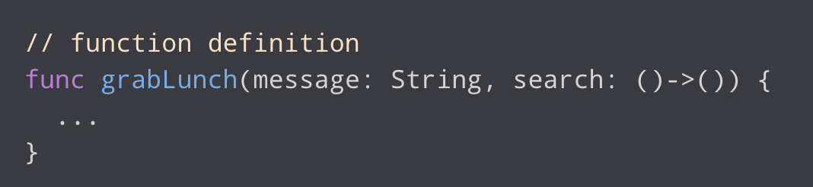
Trailing Closure
In trailing closure, if a function accepts a closure as its last parameter,
We can call the function by passing closure as a function body without mentioning the name of the parameter. For example,

Slide 14
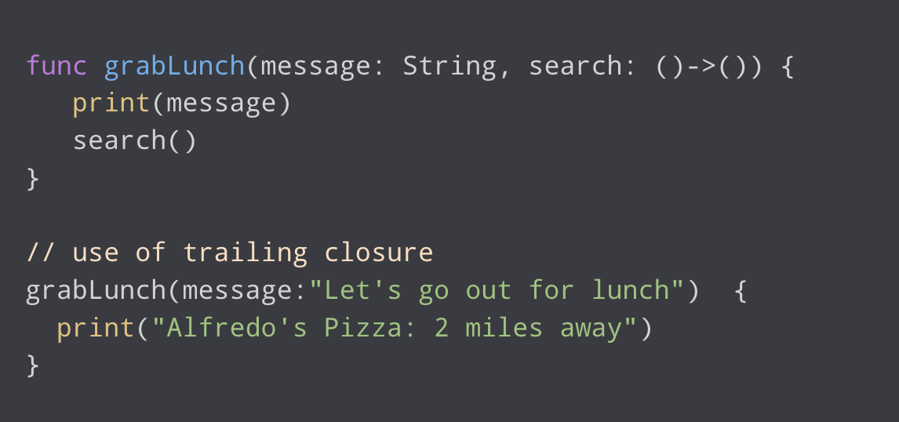
Trailing Closure Example
Output:
Let's go out for lunch
Alfredo's Pizza: 2 miles away
Notes:
grabLunch() function accepts a closure search: ( ) -> ( ). Here, closure is the last parameter of the function.

Slide 15
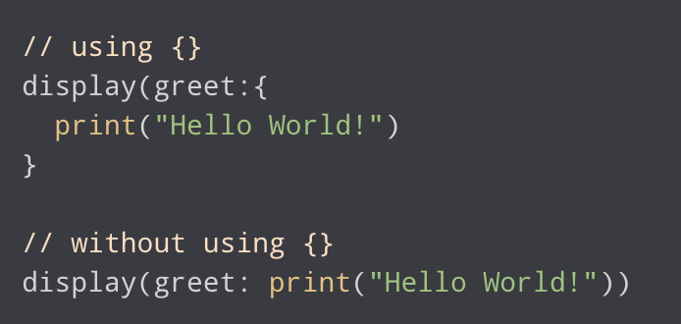
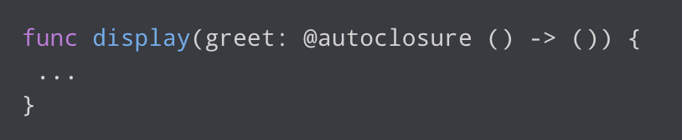
Autoclosure
While calling a function, we can also pass the closure without using the braces {}.For example,
To pass the closure argument without using braces, we must use the @autoclosure keyword in function definition. For example,
An @autoclosure in Swift is a special attribute that allows you to pass an expression as an argument to a function, which is automatically wrapped in a closure.
Notes:
This is particularly useful when you want to delay the evaluation of an expression until it's actually needed.

Slide 16
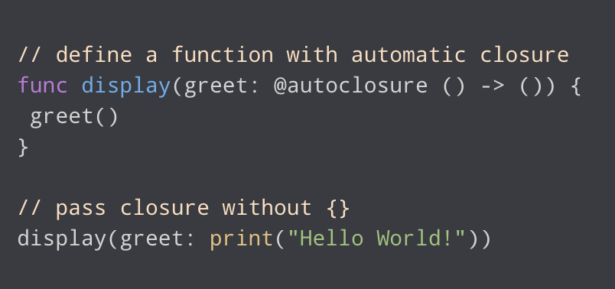
Autoclosure: Example
//Output: Hello World!
Notes:
Note: We cannot pass arguments to an autoclosure. If we try to do so we'll get the error message as: argument type of @autoclosure parameter must be ‘( )'.

